Slide 1
Reception Curriculum Meeting
With Miss Vinter

Slide 2
Miss Vinter
Mrs
Thompson
Teacher
LSAs
Reception adults
Mrs
Stockdale
Mrs Leigh
Mrs Connor

Slide 3
SPECIFIC
(provide the range of experiences and opportunities for children to broaden their knowledge and skills)
PRIME
(Lay the foundations for success in all other areas of learning)
Literacy
Comprehension
Word Reading
Writing
Maths
-Number
Numerical Patterns.
Understanding the World
Past and Present
People, Cultures and Communities
The Natural World
Expressive Arts and Design
Creating with Materials
Being Imaginative and Expressive
Personal, social and emotional development.
-Self Regulation
Managing Self
Building Relationships
Communication and Language
Listening, Attention and Understanding
Speaking
Physical Development
Gross Motor Skills
Fine Motor Skills.
17 areas of learning

Slide 4









OUR TOPICS
Our curriculum map is on the website
Why am I special?
Heroes
Big and small
Homes
Oh I do like to be beside the seaside.
Legs

Slide 5
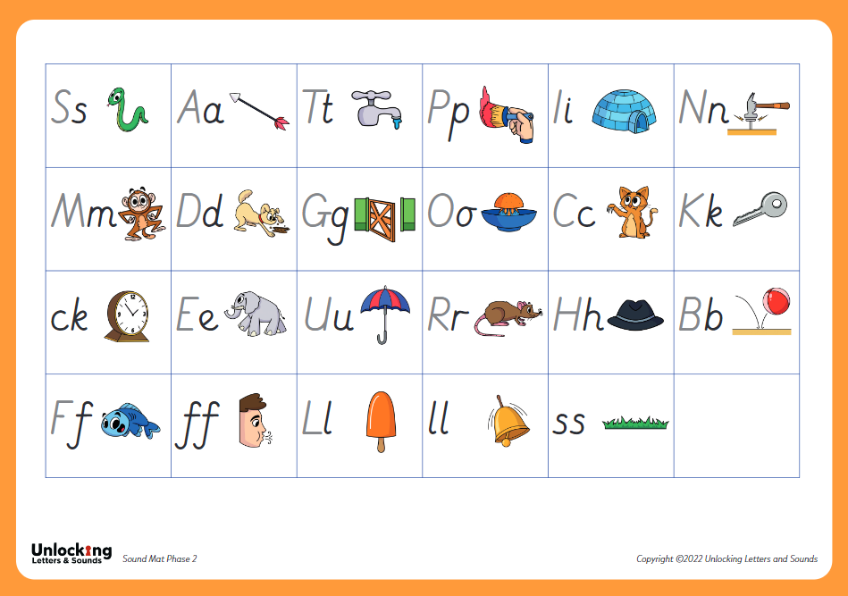
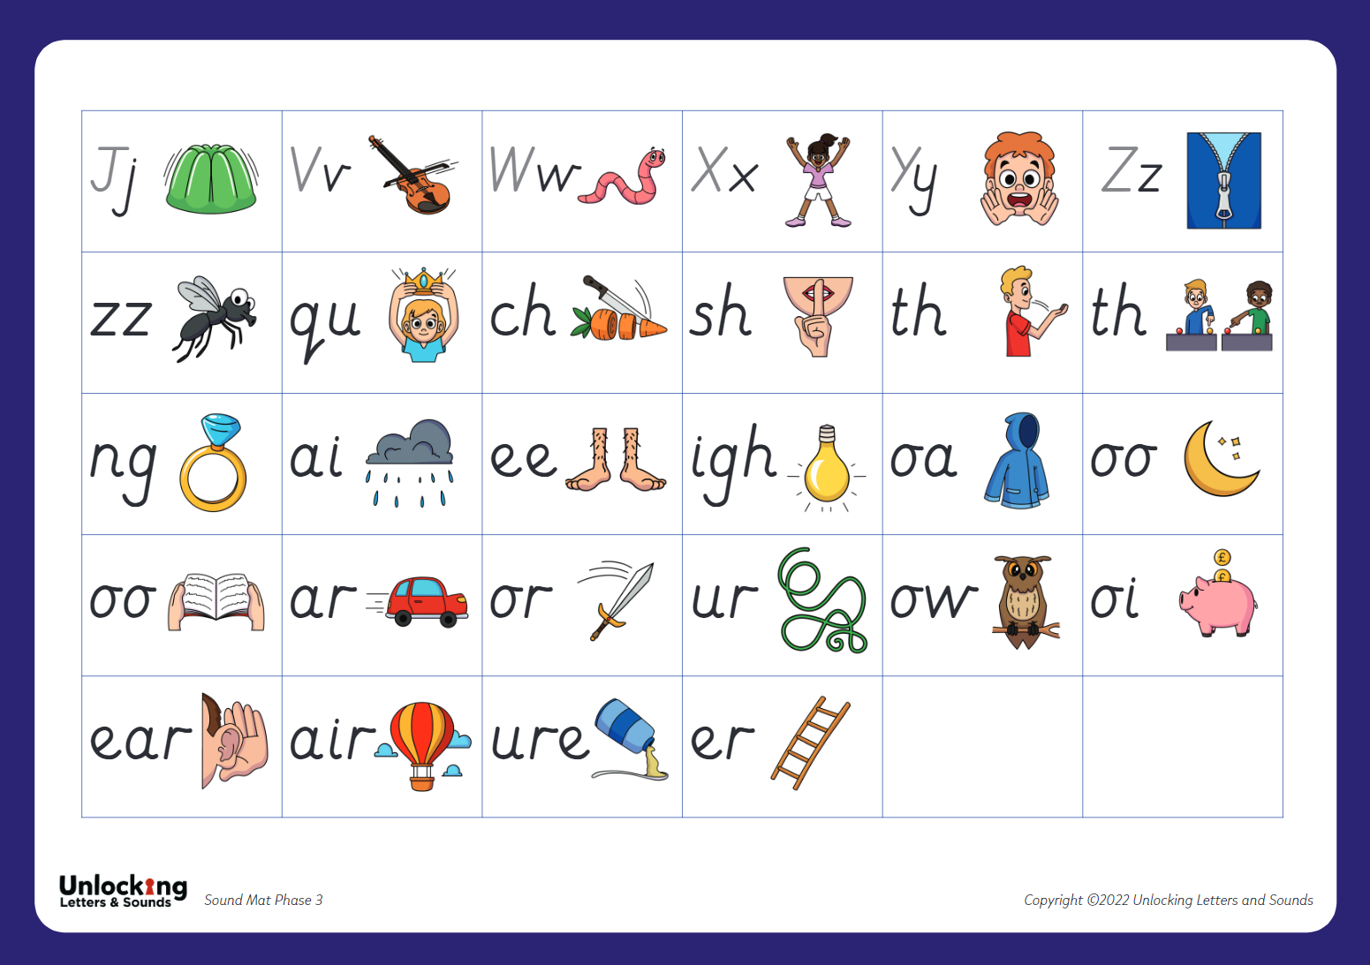

Phonics
Phase 2
Phase 3
Phonics workshop
Tuesday 23rd September
…..pm

Slide 6

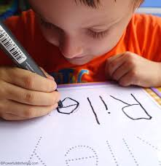
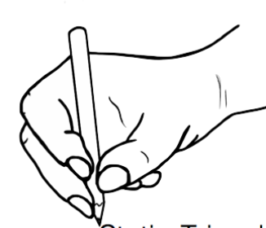


TO FOCUS ON AT HOME
Dressing, undressing, shoes, toileting.
Name writing
(Capital letter at the start and lower case for the remaining)
Daily reading ensuring correct pronunciation of the sounds and using blendy finger. Children's books will be changed once they have read the book three times and are fluently reading it. The children read twice a week with an adult and with their buddies every Friday.
Using ducky fingers when holding a pencil
(Tripod grip)
Number 0-20
-Recognition
-1 to 1 correspondence
-Ordering

Slide 7
GENERAL
Homework will be given every half term.
Snack (No nuts)
No sweets on birthdays- Any homemade cakes need to have a list of ingredients.
Trainers are needed for break, lunch and PE.
Please can all uniform, PE kit, trainers, shoes, bottles bags, coats etc. be clearly labelled.
Can the children please have a school book bag as these fit neatly into their drawers.
Plastic water bottles not metal.
PE on a Wednesday. The children will be changing at school. PE kits will be worn home after the lesson. Earrings must not be worn on PE days.
Trips
Shooting Stars Entertainment, The Travelling Natural History museum, Lion Learners. We will also hopefully have a visit from a paramedic, the police and take a trip to the fire station. The cost will be put on school money.
Please can the children bring in a named pot of playdoh and a glue stick.

Slide 8
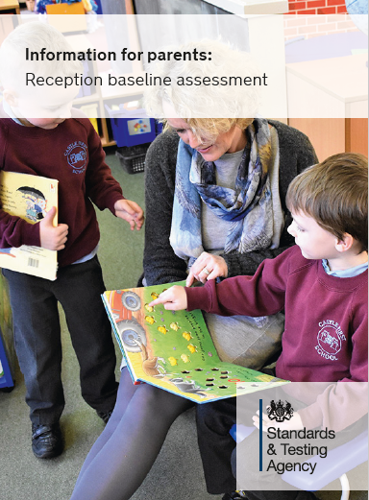
Baseline
All children within Reception will be taking part in a Government Reception Baseline Assessment (RBA) within the first 6 weeks of school. The RBA is not about judging or labelling your child or putting them under any pressure. Your child cannot ‘pass’ or ‘fail’ the assessment. Its main purpose is to create a starting point to measure the progress schools make with their pupils
The RBA is a short, interactive assessment of your child’s early literacy, communication, language and mathematics skills when they begin school, this will be completed on an iPad.
The RBA will provide an opportunity for your child to have valuable one-to-one time with me at an early stage, so I can get to know your child better. It will provide a helpful snapshot of where your child is when they enter Reception, so they can be supported in the most appropriate way.

Slide 9
Attendance
Attendance is extremely important.
You would have received all information and attendance policy in your introduction packs.
If your child’s attendance drops below 95% you will be notified and a letter sent out. We do understand that this may be due to illness and extenuating circumstances but it is a legal requirement of all schools.
If your child is also late three times you will also receive a letter. Your child will be marked as late if they arrive between 8.45 and 9.15. Any child that arrives after 9.15 will be recorded as having an unauthorised absence and this will go towards their attendance.
10 unauthorised sessions (equivalent of 5 days) means a penalty notice will be considered.

Slide 10
PSA
The PSA (Parent School Association) is a group of parents and staff and who are committed to supporting our school.
The PSA is set up to raise funds to support our school which come outside the normal range of funding.
They plan social events and activities for parents and children to enjoy throughout the year such as quizzes, sip and paint, school fete and fun days.
All money raised by the PSA is used to directly benefit all the children at the school.
We ask for Class Reps who would be willing to help support the PSA to volunteer at these events. Please let myself, the school office or Sophie Brady (Chair of the PSA) if you are able to commit to this and willing to support.

Slide 11
Amazon Wish List
As well as supporting our school with the PSA and coming to the events held we have an Amazon Wish List.
The Amazon Wish List will consist of different resources, books and items that the school needs.
If you would like to purchase and donate any of these items it would be greatly appreciated.
The links can be found on More News.

Slide 12


