Slide 1
Welcome to Year 2

Slide 2

Year 2 Curriculum
Moving into Year 2 is a big change, with different expectations and assessment at the end of the year.
Information about each subject can be found in the curriculum map on the website.

Slide 3
A great start to our day
The school day starts at 8.45, but doors open and 8.30 and all children can start early bird work which helps to make a calm start.
Messages can be passed through their reading records as these are checked each day or more urgent matters can be passed onto the office and the teacher can call back when they are not teaching the whole class.

Slide 4

Reading
The children need to read daily at home with an adult.
Aim for 10 to 15 mins. Half reading and half talking about the book.
Try to discuss the book with your child. In year 2 the focus shifts to understanding what they are reading.
Please note in reading record.
Daily reading really does make a difference – (record high this week of 93% reading every night)
Special smelly stickers, stars and certificates for children who read daily.
Still decodable books and moving onto schemes to develop comprehension. Some children will begin to change their books independently.
Don’t be concerned if your child appears to drop a level between schemes, they are not directly comparable.

Slide 5

Homework
Sent home on a Wednesday and handed in on a Monday.
This will vary, some weeks it will consist of writing super sentences based on their weekly spellings and another piece of work- this may be an Abacus interactive maths game around work we are doing in class, times tables or a task based around the foundation subjects.
Always complete in pencil.
Encourage your child to be as neat as they can and present their homework carefully.
Help as required – it’s a great opportunity for your child to have some one-to-one time.

Slide 6

Spellings and Timetables
The spelling test takes place on the Monday.
Little and often is best for spelling practise – a good opportunity for some extra handwriting practise too.

Slide 7

Uniform and Kit
Please label all uniform.
Book bag – small.
Small, plastic water bottle brought in daily, with fresh water. Please don’t put them in book bags as they often spill and spoil the books.
Glue sticks.
Pencil case- need pencil, pencil crayons, ruler, sharpener etc

Slide 8
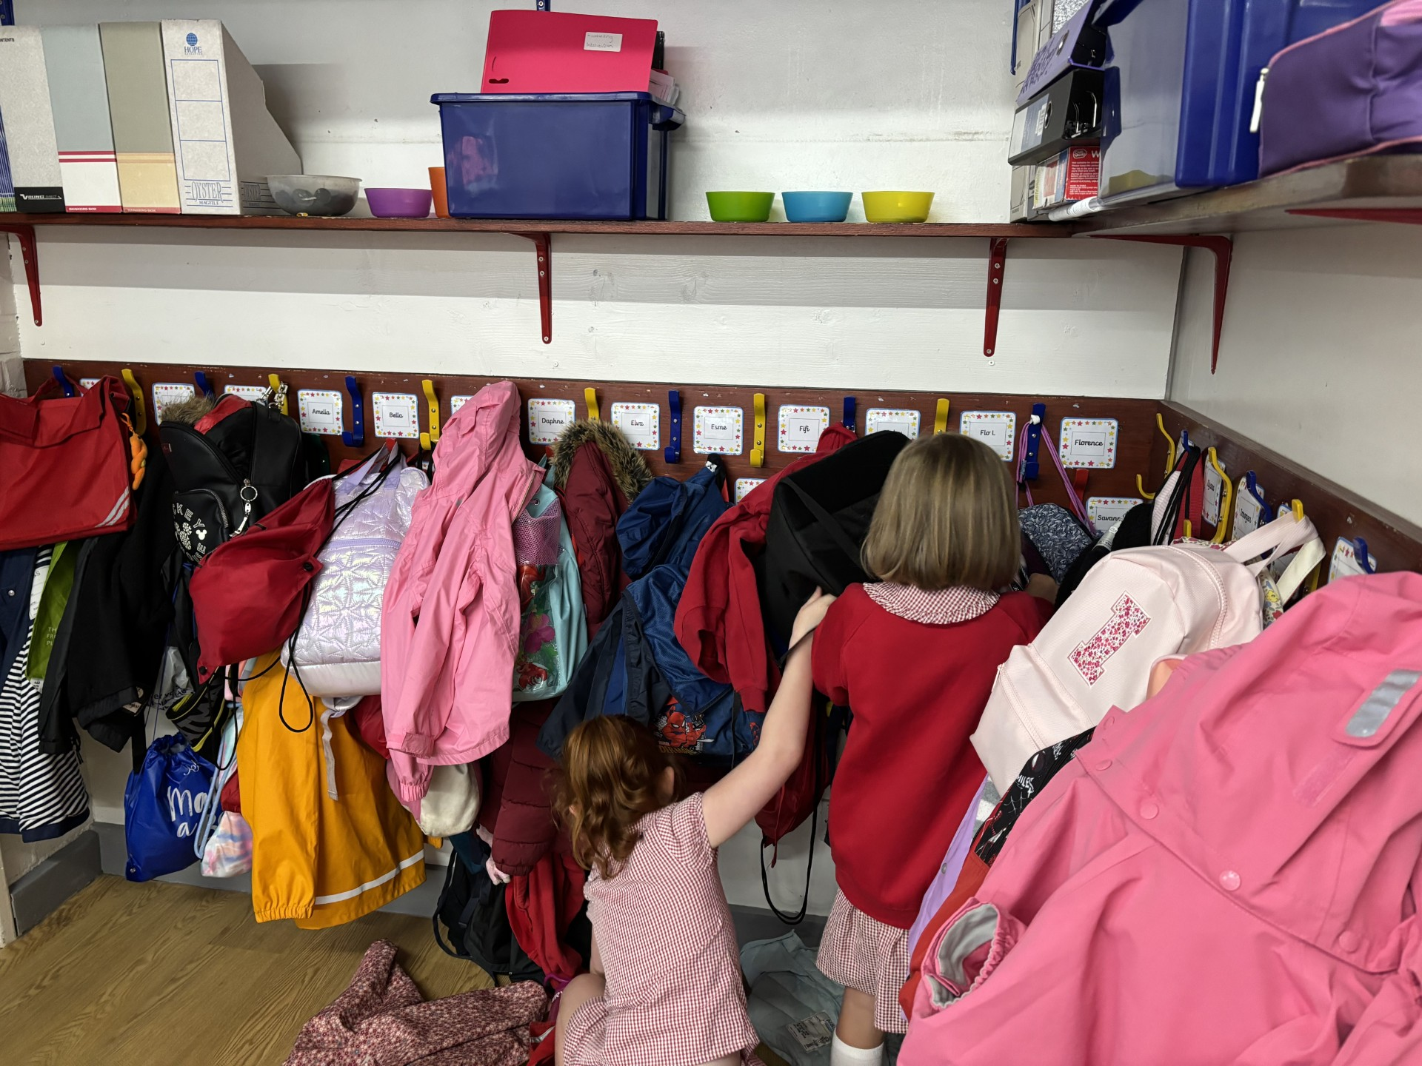
Coats and bags

Slide 9

PE Kits
PE on a Monday and Friday.
Children should wear PE kit into school on Monday and the kit will be sent home each Friday to be washed over the weekend.
If your child wears PE kit for an after school club please send it back into school the next day.
Kit and bags labelled on the outside so it is easy and quick to correct any mix ups.
Cannot wear earrings during PE lessons.
If wearing tights, please ensure children have socks in their PE bag to wear with their trainers.

Slide 10

Swimming
Every Tuesday afternoon- leave school at 2pm to walk to Lord Butler.
Swimming lesson is from 2.30- 3pm.
Please pick up your child from the leisure centre at 10 past 3. If you have other children at school please prioritise picking up from the pool 1st.
Swimming kit- no loose trunks for boys, swimming costume for girls. Name on outside of swimming hat.
Parent Rota for helpers

Slide 11
More News
Please remember to read More News each week as it always has important dates and school information.
We try to keep emails to a minimum by putting information on More News whenever possible.
As well as being emailed to you weekly, it is also available on the website.

Slide 12
Trips and Visits
Forest School-summer term- price similar to last year which was £35
Parent helpers- reading, swimming, trips.
Tower of London - Trip Spring Term (approx £30)

Slide 13

Amazon Wishlist

Slide 14
Any Questions?

